Slide 1
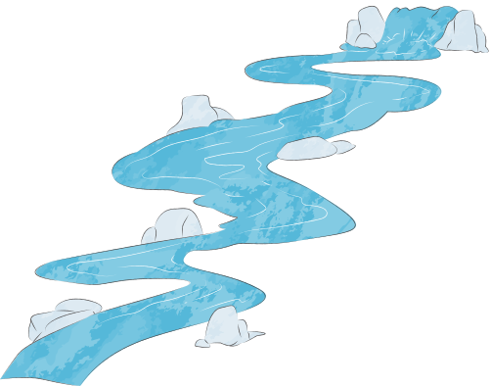

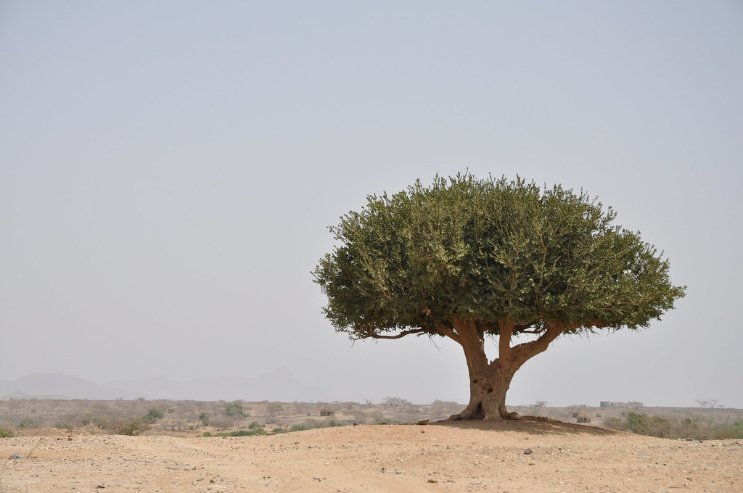
Physical factors influencing water access
Climate
Places with high rainfall and low evaporation have more available water, while dry or hot regions often face scarcity. Seasonal patterns (wet/dry seasons) also affect how reliable water supplies are.
"Trees in a dry land" by Julien Harneis is licensed under CC BY-SA 2.0. https://openverse.org/image/d8a4888d-270c-442f-a087-db2997c4dbf4?q=dry+land&p=1

Slide 2
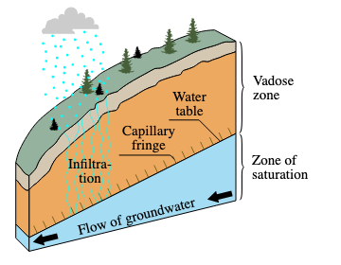
Physical factors influencing water access
Geology
The type of rock and soil affects how much water can soak in or be stored underground. Permeable rocks allow aquifers to form, while certain minerals can dissolve into groundwater and affect its quality.

Slide 3

Physical factors influencing water access
Topography
Steep slopes create fast runoff and less infiltration, while low, flat areas allow water to pool and rivers to move more slowly. Mountain ranges also direct where rivers flow.
Vegetation
Areas with dense vegetation promote infiltration, protect soil and help maintain groundwater and river flow. Cleared landscapes often have more runoff and lower water quality.

Slide 4
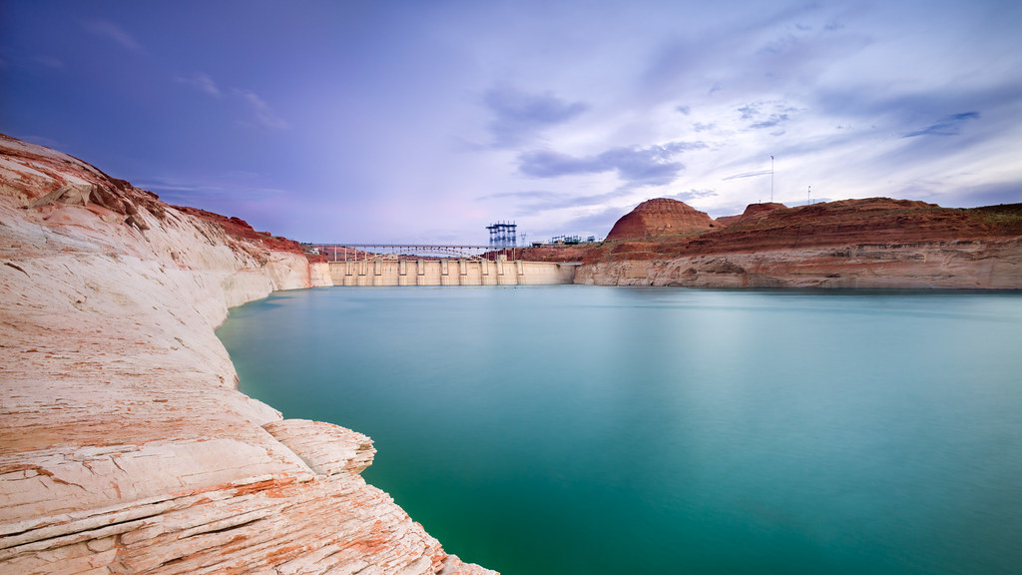
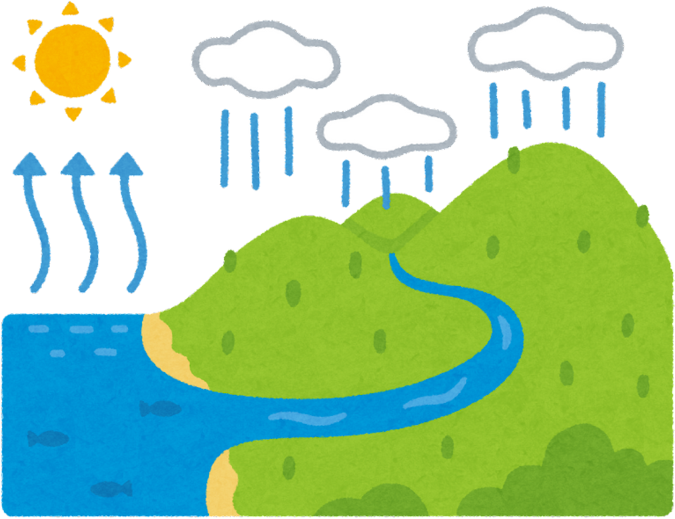
Human factors influencing water access
Infrastructure; such as dams, pipes, treatment systems
Good infrastructure increases access to safe water, but limited or old systems can restrict supply or reduce water quality, especially in remote communities.
"Beyond the Dam" by romainguy

Slide 5
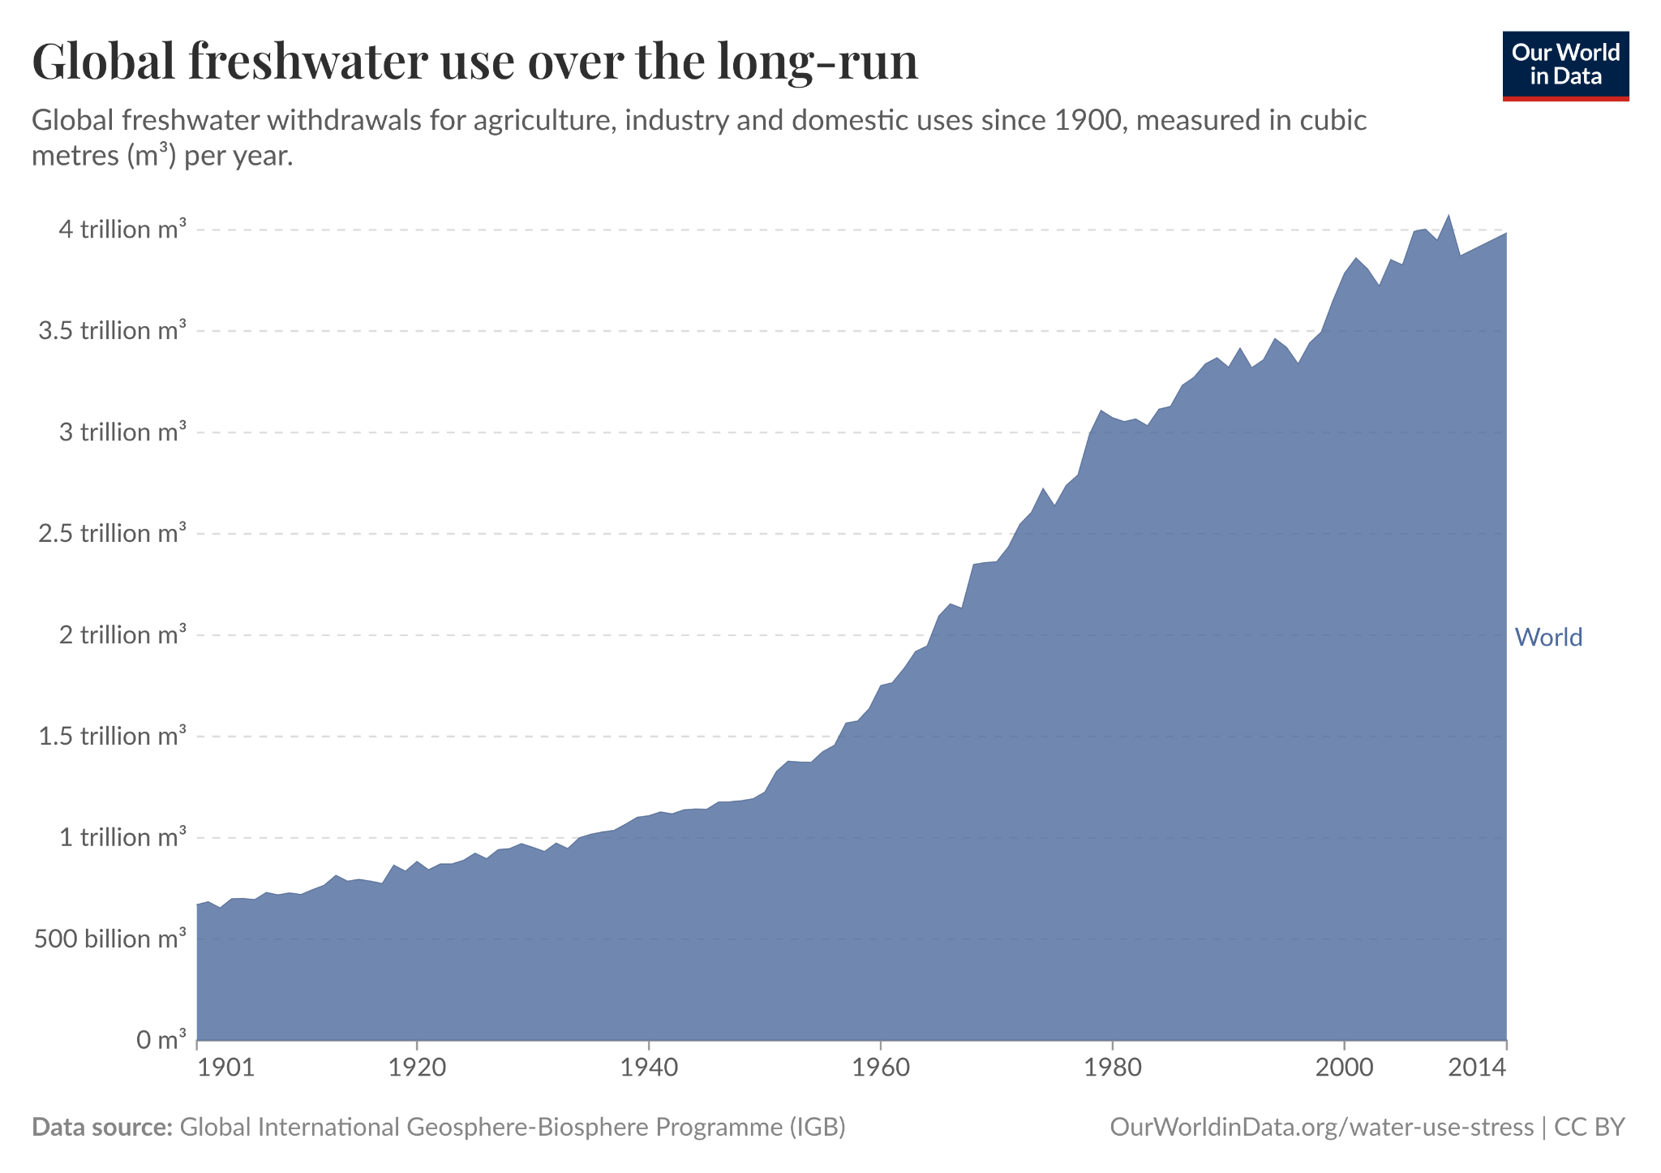
Human factors influencing water access
Water use and demand
Agriculture, industry and growing cities use large amounts of water. If demand is high in a dry region, scarcity becomes more likely.

Slide 6
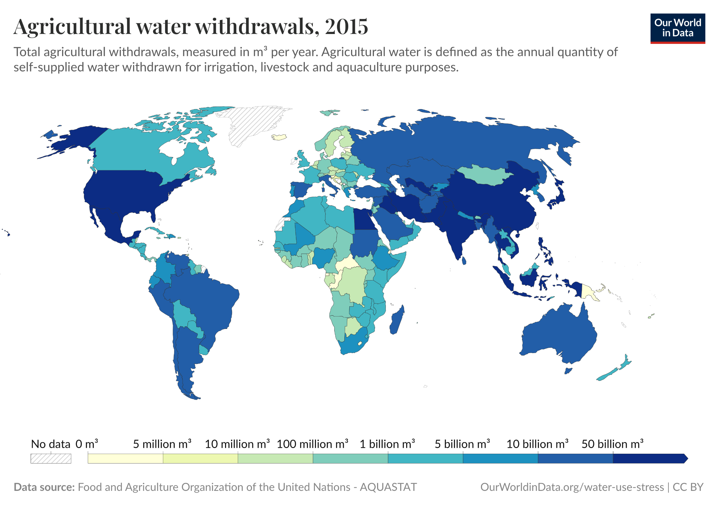
Example: Agriculture
Conduct PQE on this map

Slide 7

Human factors influencing water access
Land use changes
Urbanisation and land clearing increase runoff and reduce infiltration, altering river flows and groundwater recharge. Pollutants also enter waterways more easily.
Management and governance
Who controls water resources, how they are funded and how they are maintained all affect availability. Poor management can create shortages.

Slide 8


ACTIVITY
Read the different scenarios and identify the factors influencing water access in each one.
Notes:
Worksheet 3.1

Slide 9

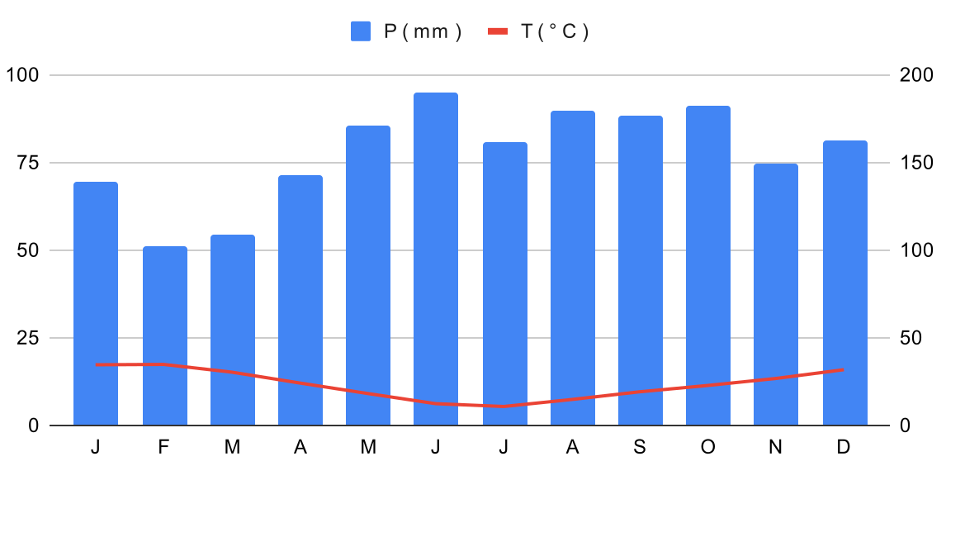
Climate graphs!
Climate graphs display information about the climate of a location. The line graph shows the average temperature each month, whilst the bar graphs show the average rainfall for each month (think of them as ‘cups’ of rainfall!).
Remember:
Check which side of the graph to use for precipitation (mm) or temperature (°C).
https://commons.wikimedia.org/w/index.php?curid=145957894
Notes:
Worksheet 2.2

Slide 10
ACTIVITY
Construct the climate graph you are provided and answer the questions!
Notes:
Worksheet 3.2

